Slide 1
Black Box Testing Equivalent Partitioning
Prepared by Chala Urgessa
naurgessa@gmail.com

Slide 2
Equivalence Partitioning 等价划分
It is a good all-round specification-based black-box technique. It can be applied at any level of testing and is often a good technique to use first.
It is a common sense approach to testing, so much so that most testers practice it informally even though they may not realize it.
The idea behind the technique is to divide (i.e. to partition) a set of test conditions into groups or sets that can be considered the same.

Slide 3
Equivalence Partitioning
Equivalence Partitioning is a smart way to test software with less work. Here's the idea:
Imagine all the things we can test in a program as a big set of inputs.
Here’s how it works
We break this big set into smaller sets, called equivalence classes.
We think all inputs in one small set behave the same way in the program.
So, we pick just one input (a representative) from each set to test. If this test passes, we guess that all inputs in that set would also pass.
This doesn't mean we're 100% sure, but it's a good guess that saves a lot of time.
Testing like this lets us cover more ground with fewer tests.
It's a smart shortcut: test one, infer about many. This way, we can efficiently check if the software does what it should with different kinds of inputs.

Slide 4
Equivalence Partitioning ( Cont...)
This saves time because we don't test everything.
Remember, this is a basic idea. It might not always be perfect, but it helps us start testing.
If possible, try a few tests in each group to be sure, especially for things users do a lot.
This method makes testing faster and helps us focus on what to test first.

Slide 5
Equivalence Partitioning (Cont...)
Two steps are required to implementing this method:
The equivalence classes are identified by taking each input condition and partitioning it into valid and invalid classes.
For example:
if an input condition specifies a range of values from 1 to 999, we identify one valid equivalence class [1<item<999]; and two invalid equivalence classes [item<1] and [item>999]
Generate the test cases using the equivalence classes identified in the previous step. This is performed by writing test cases covering all the valid equivalence classes.
Then a test case is written for each invalid equivalence class so that no test contains more than one invalid class. This is to ensure that no two invalid classes mask each other.

Slide 6
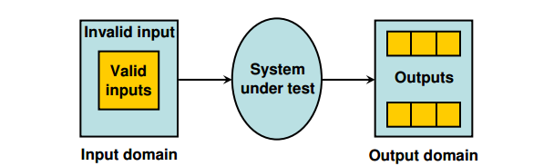
Equivalence Partitioning
Fig : Equivalence partitioning
Most of the time, equivalence class testing defines classes of the input domain. However, equivalence classes should also be defined for output domain. Hence, we should design equivalence classes based on input and output domain.

Slide 7
Example 3.1
Consider a program for the determination of the nature of roots of a quadratic equation. Its input is a triple of positive integers (say a,b,c) and values may be from interval [0,100]. The program output may have one of the following words.
[Not a quadratic equation; Real roots; Imaginary roots; Equal roots]
Identify the equivalence class test cases for output and input domains.

Slide 8
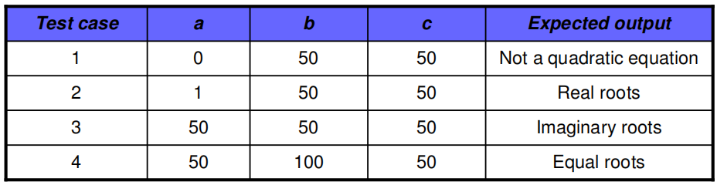
Solution
Output domain equivalence class test cases can be identified as follows:
O1={<a,b,c>:Not a quadratic equation if a = 0}
O1={<a,b,c>:Real roots if (b²-4ac)>0}
O1={<a,b,c>:Imaginary roots if (b²-4ac)<0}
O1={<a,b,c>:Equal roots if (b²-4ac)=0}`
The number of test cases can be derived form above relations and shown below:

Slide 9
Cont ...
We may have another set of test cases based on input domain.
I1= {a: a = 0}
I2= {a: a < 0}
I3= {a: 1 ≤ a ≤ 100}
I4= {a: a > 100}
I5= {b: 0 ≤ b ≤ 100}
I6= {b: b < 0}
I7= {b: b > 100}
I8= {c: 0 ≤ c ≤ 100}
I9= {c: c < 0}
I10={c: c > 100}

Slide 10
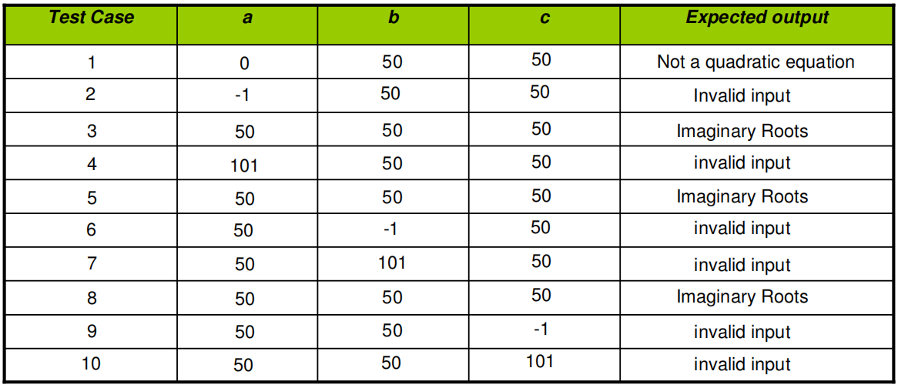
Cont ...
Here test cases 5 and 8 are redundant test cases. If we choose any value other than nominal, we may not have redundant test cases. Hence total test cases are 10+4=14 for this problem.

Slide 11
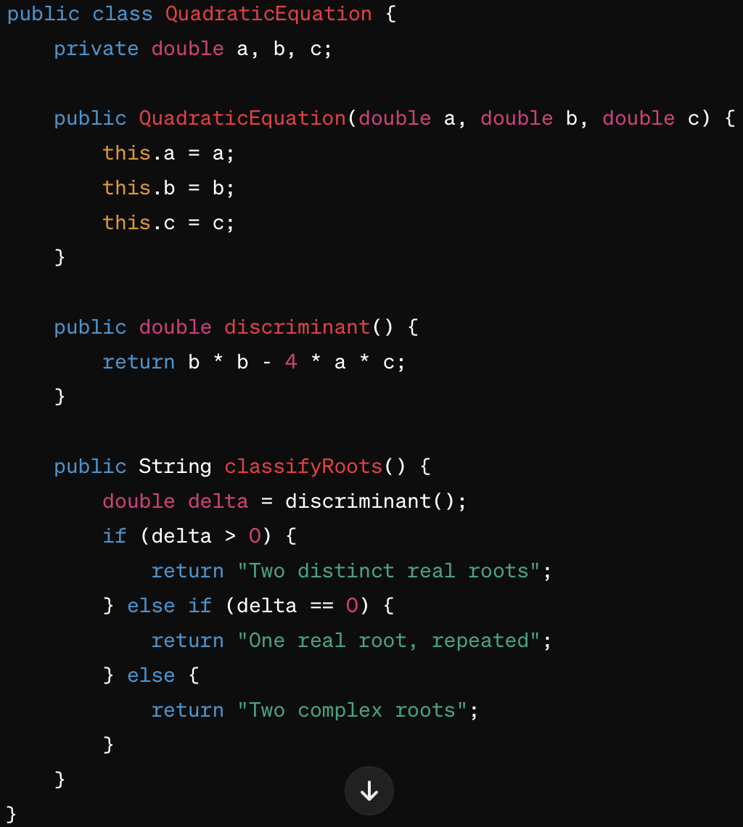

Slide 12
Step 1: Create Tests with JUnit 5
First, ensure you have JUnit 5 added to your project's dependencies. If you're using Maven, add the following dependency to your pom.xml:
<dependency>
<groupId>org.junit.jupiter</groupId>
<artifactId>junit-jupiter</artifactId>
<version>5.7.0</version>
<scope>test</scope>
</dependency>

Slide 13
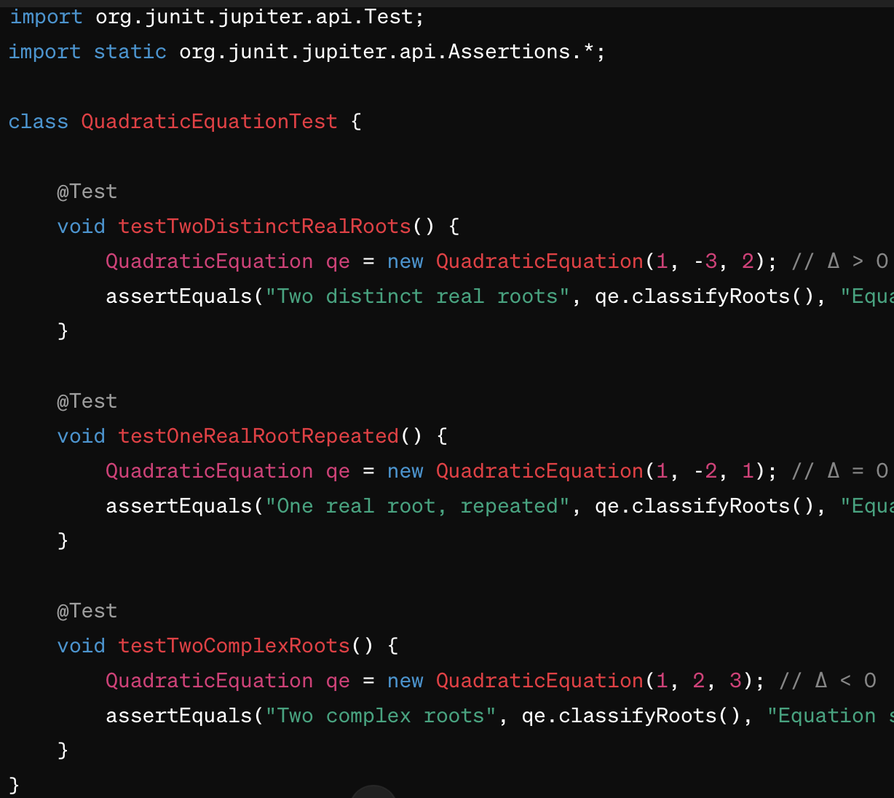

Slide 14
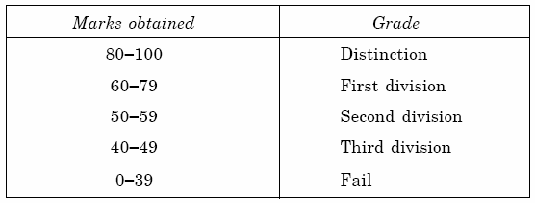
Example 3.2. Class Activity
Let us consider an example of grading the students in an academic institution. The grading is done according to the following rules:
Generate test cases using equivalence class testing technique and write the implementation alongside.

Slide 15
Solution
1. Valid Equivalence Classes
VE1: 80-100 (inclusive) for “Distinction”
...
2. Invalid Equivalence Classes
IE1: Marks below 0 (negative marks)
IE2: Marks above 100

Slide 16
Implementation
public void testInvalidMarksAboveHundred() {
Assertions.assertEqual(“Invalid marks”, calculator.calculateGrade(101));
}

Slide 17
Example 3.3: Homework
Consider a program for determining the Previous date. Its input is a triple of day, month and year with the values in the range
1 ≤ month ≤ 12
1 ≤ day ≤ 31
1900 ≤ year ≤ 2025
The possible outputs would be Previous date or invalid input date. Identify the equivalence class test cases for output & input domains.

Slide 18
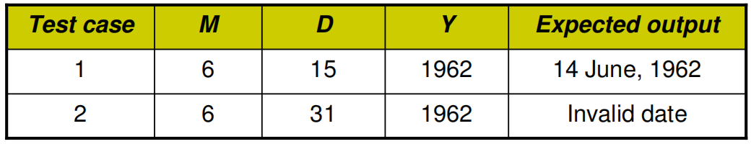
Solution
Output domain equivalence class are:
O1={<D,M,Y>: Previous date if all are valid inputs}
O1={<D,M,Y>: Invalid date if any input makes the date invalid}

Slide 19
We may have another set of test cases which are based on input domain.
I1={month: 1 ≤ m ≤ 12}
I2={month: m < 1}
I3={month: m > 12}
I4={day: 1 ≤ D ≤ 31}
I5={day: D < 1}
I6={day: D > 31}
I7={year: 1900 ≤ Y ≤ 2025}
I8={year: Y < 1900}
I9={year: Y > 2025}

Slide 20
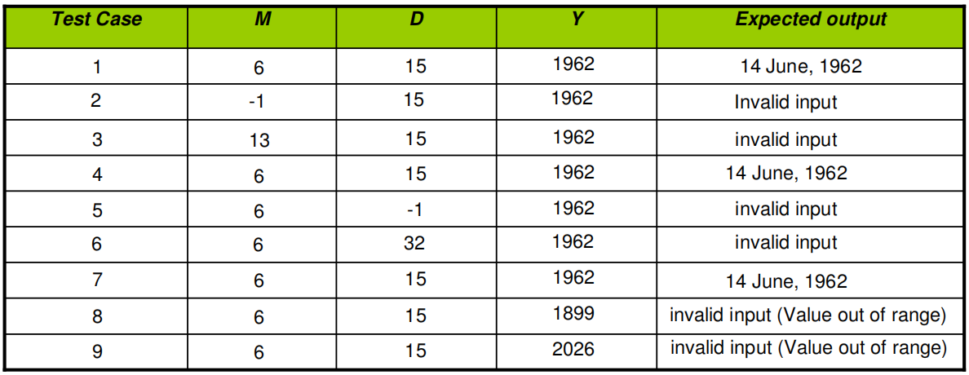
Inputs domain test cases are :

